Slide 1
Capital Gains & Losses (Including Sale of Home)
Pub 17 Chapters 13-16
Pub 4012 Tab D
(Federal 1040-Line 13)
(NJ 1040-Line 18)
Notes:
1

Slide 2
Tax Liability Net Loss
Net loss can offset all gains, plus
Up to $3,000 can be used to reduce other taxable income in the current tax year ($1,500 if MFS)
The loss amount in excess of $3,000 (or $1,500 if MFS) is carried forward to the next tax year
NJ only allows taxpayer to use capital losses to offset capital gains in the same year. No net capital loss is permitted
Notes:
2

Slide 3
Capital Loss Carryover
Check prior year Schedule D or related worksheet to determine carryover loss
Carryover losses keep their short-term or long-term classification
Carryover losses are combined with the gains and losses that actually occur in the current year
Up to $3,000 ($1,500 if MFS) loss offsets other income on current year return. Rest of loss is carried forward to next year
No limit to how many times a loss can be carried forward
No capital loss carryover allowed in NJ
Notes:
3

Slide 4
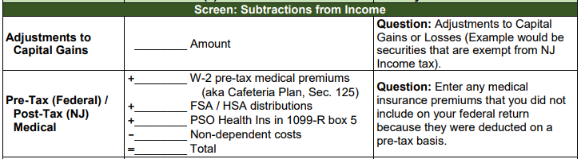
Non-Taxable NJ Securities
Gains on certain NJ Securities are exempt from NJ tax even though subject to Federal capital gains tax
See NJ Bulletin GIT-5 for a list of these securities (link from TaxPrep4Free.org Preparer page)
The NJ return has to be adjusted when this situation occurs
Capture exempt capital gains amount in NJ Checklist Subtractions from Income section for later entry in TaxSlayer State section

Slide 5
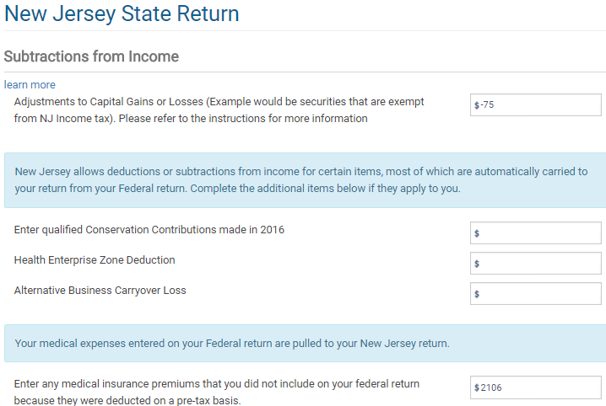
NJ Adjustment to Capital Gains
Subtract out amount of capital gains on NJ
securities that are tax exempt

Slide 6
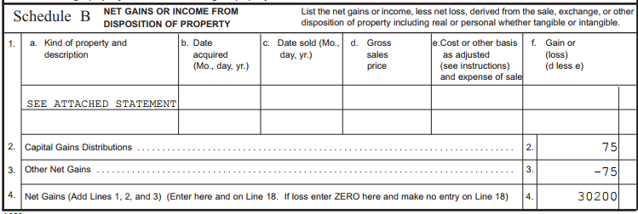
NJ Sch B
Subtract out amount of capital gains on NJ
securities that are tax exempt

